Slide 1
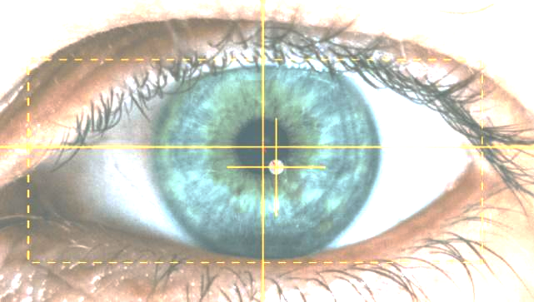


A System that sees your needs
Capstone Project Phase B
24-1-R-23
Students: Einan Cohen and Liraz Akiva
Supervisor: Dr. Julia Sheidin
Notes:
our project is part of flagship project at Brauda College …

Slide 2
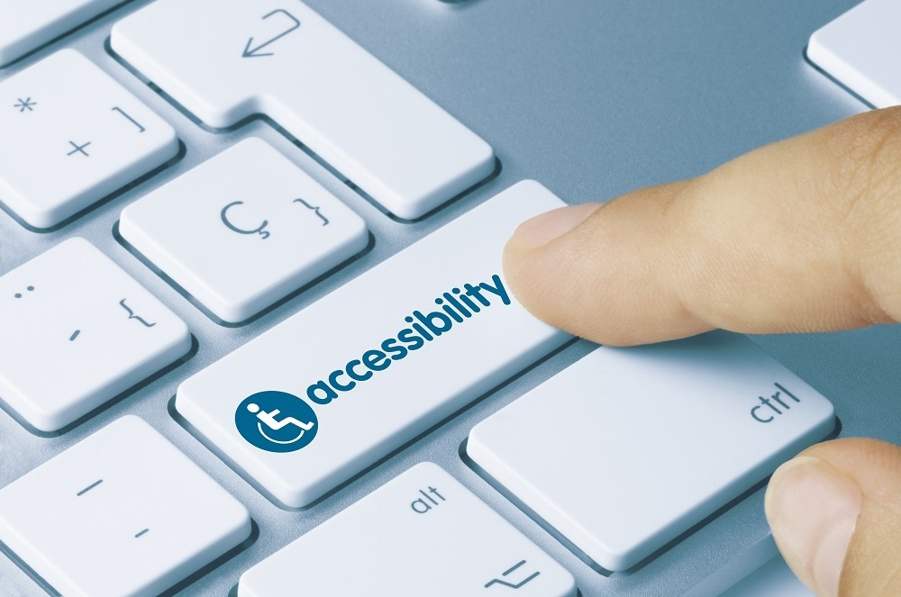
The Problem
Many individuals with physical disabilities face significant challenges when interacting with standard computer hardware and software.
Despite modern accessibility features, there are gaps in usability, particularly in complex software environments.

Slide 3

Our Client - Tal
Tal has muscular dystrophy and uses eye-tracking technology with gaze focusing to interact with the computer.
Tal uses Adobe Premiere Pro software to edit video files.

Slide 4
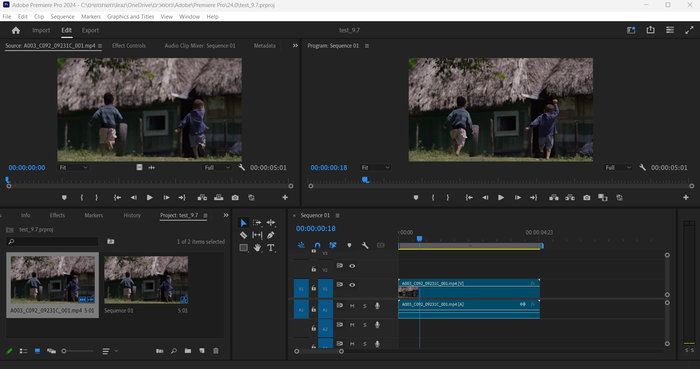
Adobe Premiere Pro

Slide 5
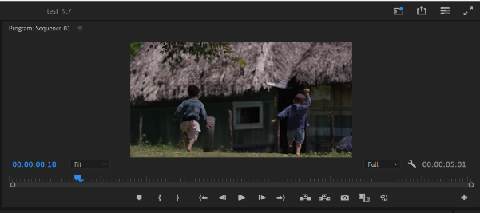
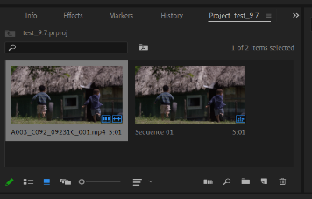
A window that allows you to open a video folder
A window that allows you to open a video folder

Slide 6
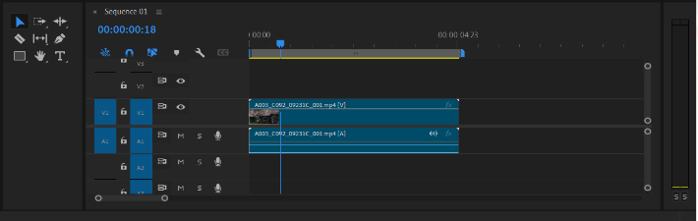
The TIMELINE window where Tal edits the video files.

Slide 7
How did Tal work before the panel?
Use TD Control software to replace mouse and keyboard actions with gaze focus.
Tal had difficulty editing the video files with an emphasis on operations that require precision.

Slide 8
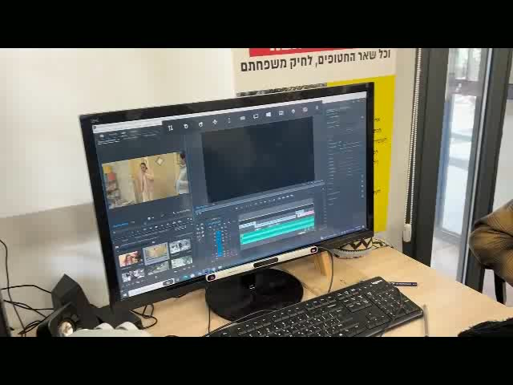

Slide 9

Solution Description
Develop a tool that can help Tal overcome his difficulties with an emphasis on a level of accuracy when working with the Premiere Pro.
The tool will be designed in a friendly and easy-to-use manner.
Allow Tal to be independent.

Slide 10

Our Solution
A side panel that allows Tal to perform actions in Premiere Pro.
The panel includes buttons that execute Premiere Pro keyboard shortcuts to carry out different actions within the software.
The buttons perform automatic actions to simplify certain tasks.

Slide 11
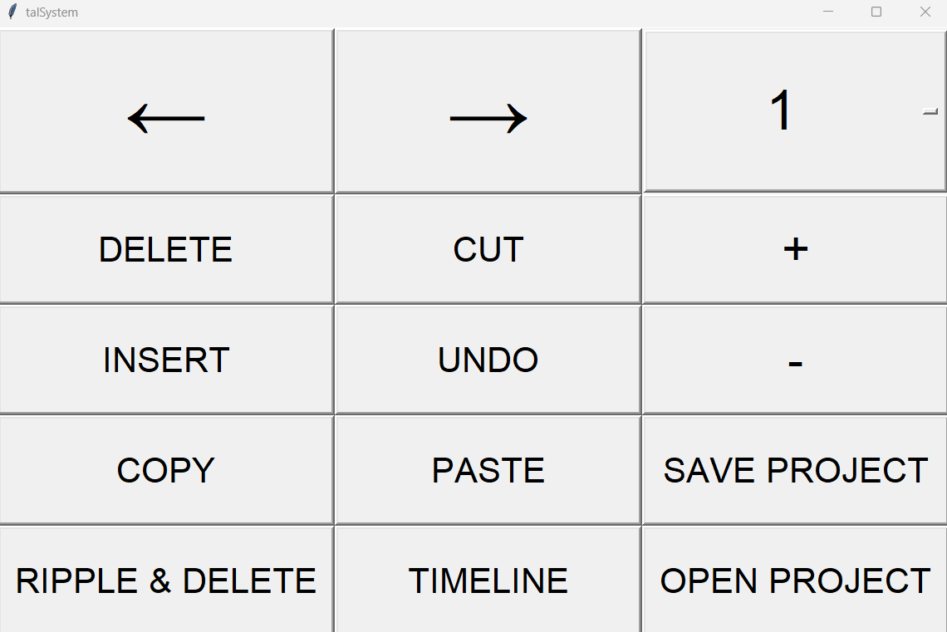
The Panel

Slide 12
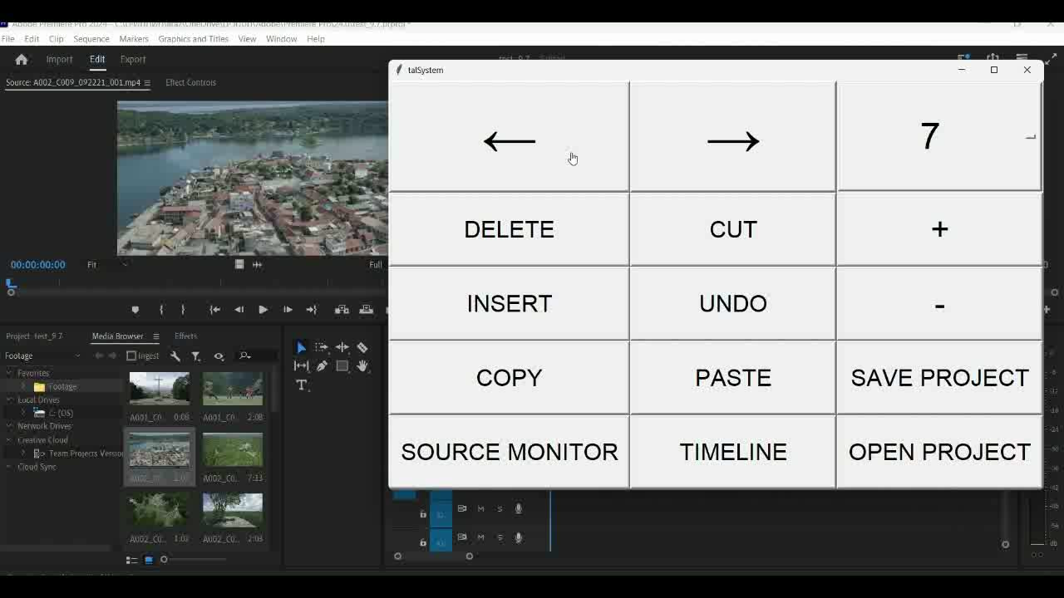
Simple & Accurate

Slide 13
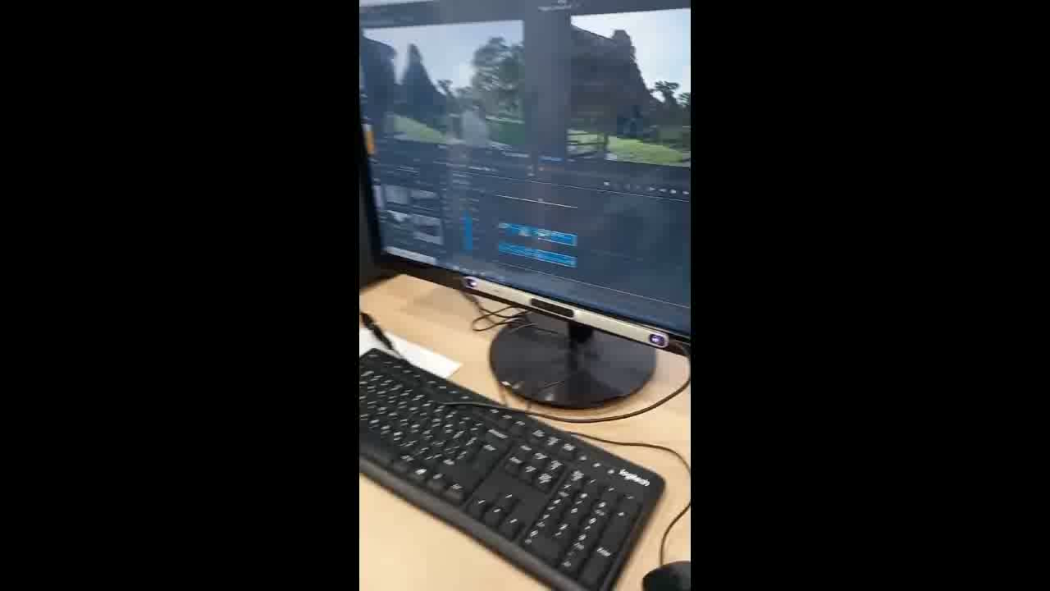
Simple & Accurate

Slide 14
Technical Challenges
Premier Software Versions
•Issue: Functionality differences due to varying software versions.
•Solution: Updated Tal’s software to the latest version and adjusted settings for optimal performance.
Security Issues:
•Issue: Security blocks triggered by the lightweight software development.
•Solution: Refined the development approach to prevent security warnings while maintaining efficiency.

Slide 15
Design Challenges
Panel Design
•Issue: Initial design with images and text overwhelmed Tal.
•Solution: Simplified the interface by removing images and using minimal colors and text.
Button Size
•Issue: Balancing button size for usability with screen space constraints.
•Solution: Tested and optimized button size using eye-tracker feedback to ensure ease of use without overwhelming the screen.

Slide 16


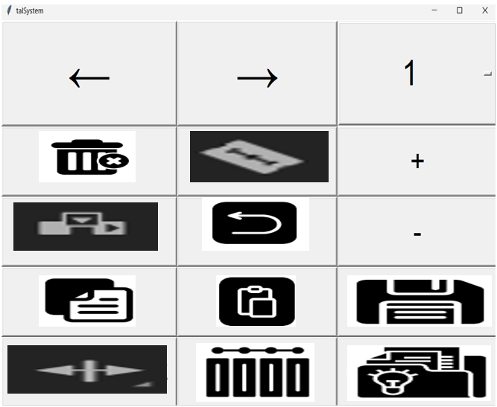
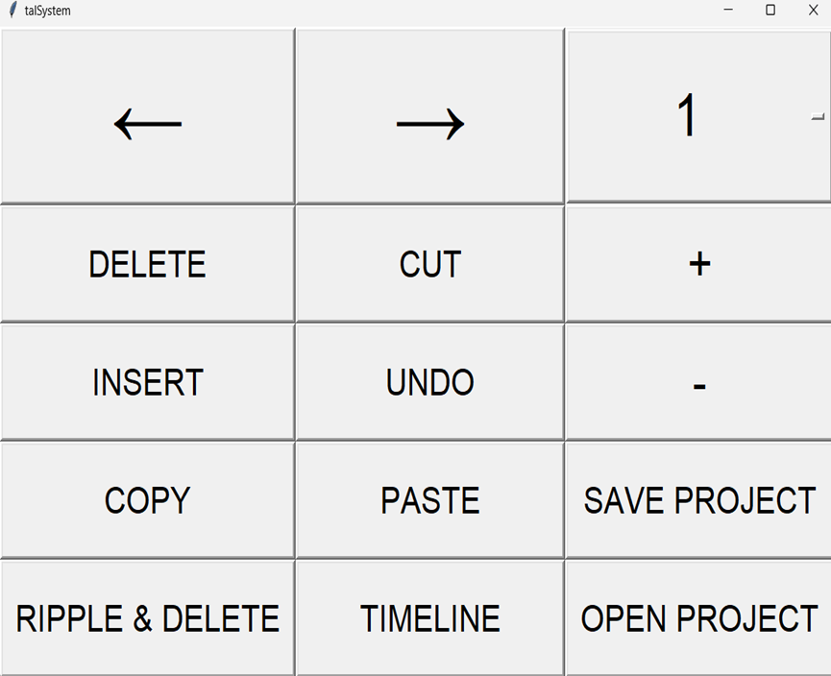

Slide 17
Usability Challenges
Panel Location
•Issue: Finding the best panel placement to fit Tal's workflow and vision needs.
•Solution: Experimented with various placements, concluding that a larger panel on the right side of the screen is most effective for Tal’s usage.

Slide 18
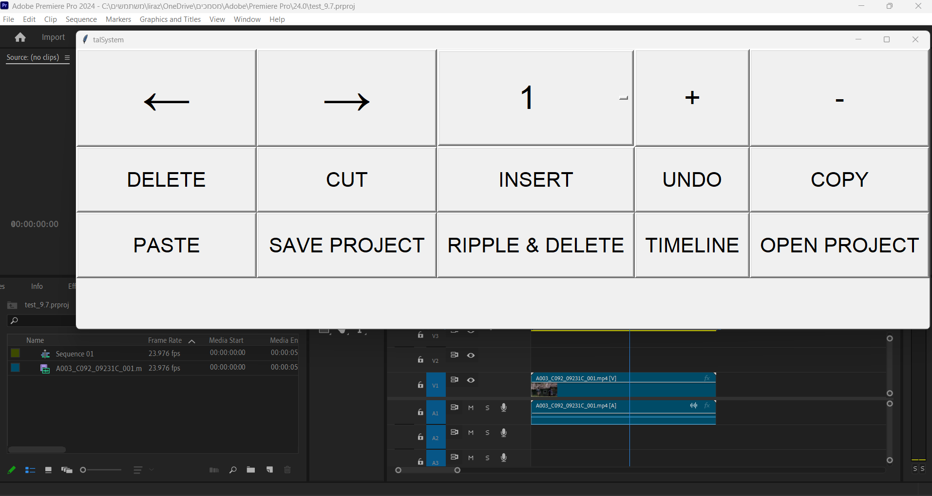

Slide 19
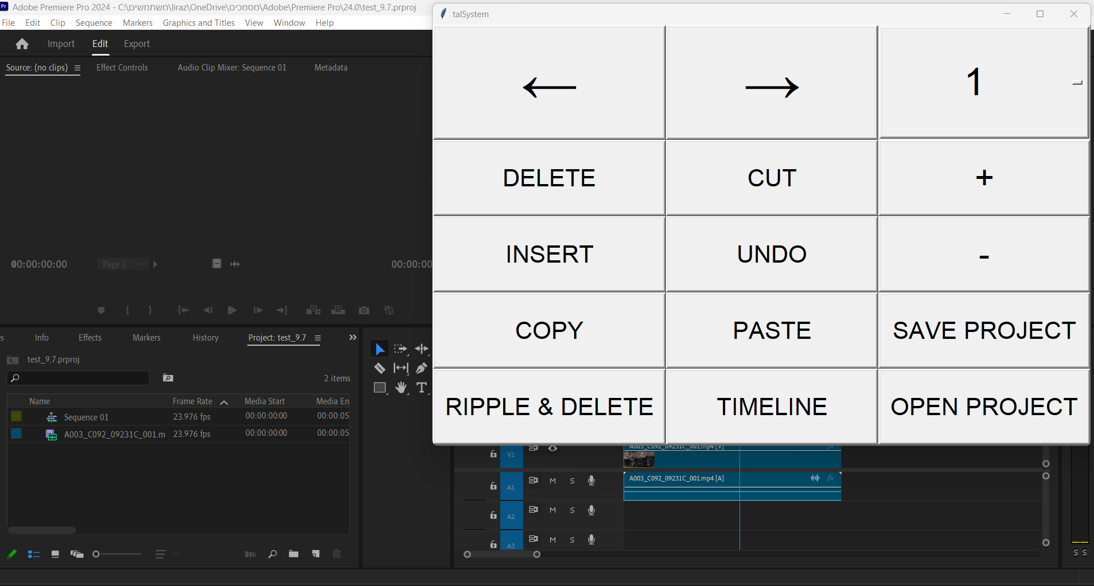

Slide 20
Future Work
The project can also be designed for other programs besides Adobe Premiere.
The panel can be used for any software that has keyboard shortcuts.
The panel can be made accessible to other disabled people who use different software through gaze focusing.

Slide 21


